Slide 1


FAST TAG FRAUD DETECTION
SALEM M.ALKOOUR
DATE : 6/22/2024

Slide 2
PROBLEM STATEMENT
The main objective of this project is to detect fraudulent Fastag transactions accurately. Given the dataset, which contains various features related to transactions, we need to identify patterns indicative of fraud. This will involve handling challenges such as imbalanced data and feature engineering to capture nuanced patterns.

Slide 3
DATASET DESCRIPTION
01
Transaction_ID: Unique identifier for each transaction.
02
Timestamp: Date and time of the transaction.
03
Vehicle_Type: Type of vehicle involved in the transaction.
04
FastagID: Unique identifier for Fastag.
05
TollBoothID: Identifier for the toll booth.
06
Lane_Type: Type of lane used for the transaction.
07
Vehicle_Dimensions: Dimensions of the vehicle.
08
Transaction_Amount: Amount associated with the transaction.
09
Amount_paid: Amount paid for the transaction.
10
Geographical_Location: Location details of the transaction.
11
Vehicle_Speed: Speed of the vehicle during the transaction.
12
Vehicle_Plate_Number: License plate number of the vehicle.
13
Fraud_indicator: Binary indicator of fraudulent activity (target variable)

Slide 4
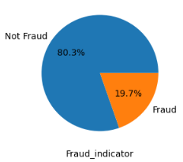
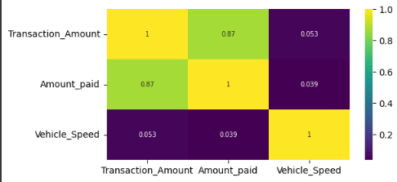
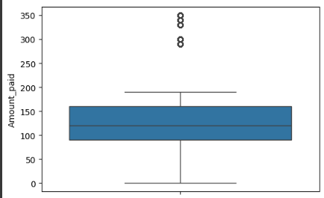
DATA EXPLORATION
Visualize data
We used libraries like Matplotlib and Seaborn to understand the trends and relationships within the data.

Slide 5
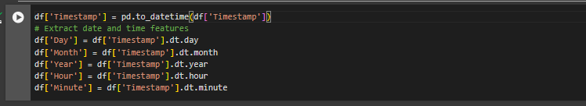
FEATURE ENGINEERING
Create new features or transform existing ones that
While analyzing the data, we found that we can derive several new columns from the timestamp column, namely Day, Month, Year, Hour, and Minute.

Slide 6
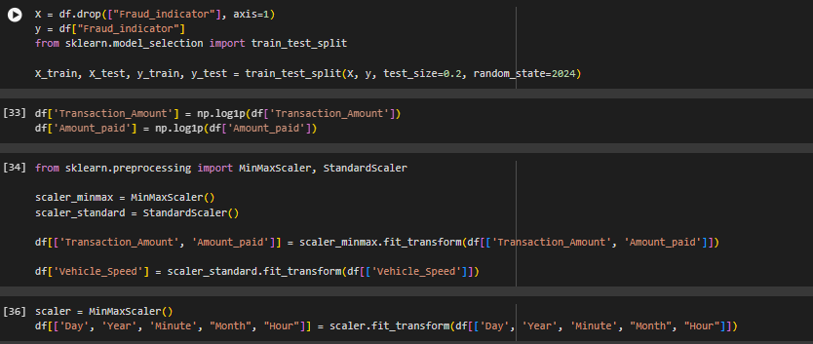
DATA PREPROCESSING
Prepare data for model training
missing values
encode categorical variable
scale features

Slide 7
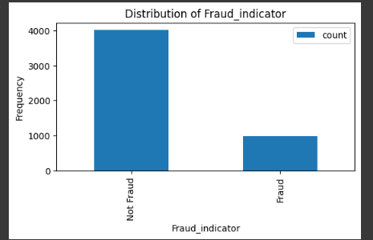

HANDLING IMBALANCED DATASETS
Imbalanced dataset issues due to the likely low occurrence of fraud.
We employed SMOTE to address the issue.

Slide 8
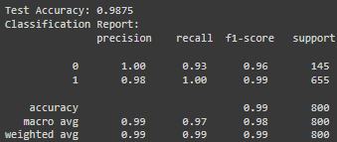
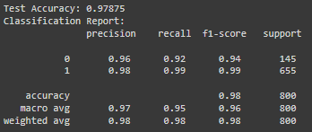
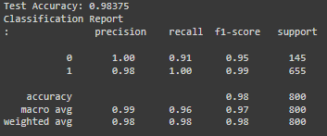
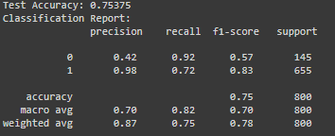
MACINE LEARNING MODEL DEVELOPMENT
Logistic Regression
KNeighbors Classifier
RandomForest Classifier
SVC

Slide 9
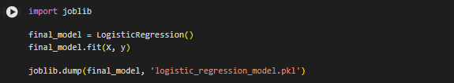
CONCLUSION
Best Model: Logistic Regression (slightly edges out Random Forest with marginally higher accuracy and overall consistent performance).
Next Best Model: Random Forest (almost equivalent to Logistic Regression but with slightly lower accuracy).
Both Logistic Regression and Random Forest are suitable for deployment, but Logistic Regression's slight edge in accuracy makes it the preferred choice.

Slide 10
THANK YOU
Salem alkour

